Slide 2
Data Collection and Preparation
Collected per-minute data from March 6, 2014 through present on headache level, food, biometrics (Basis Watch), GPS location, calendar events, etc.
Today’s analysis is based on a subset of the data comprising close to 400,000 per-minute data points across approximately 90 features extracted. Features chosen based on common migraine triggers (https://uhs.berkeley.edu/home/healthtopics/pdf/triggers.pdf).
Large dataset is here: http://bit.ly/1vFyid0 (warning: 85.9 MB)
Future datasets should incorporate other data including weather (with GPS data as well as credible allergen data from Bay Area Pollen database), food ingredients (e.g., nitrates from preserved meats, sucralose, MSG, etc.), sleep data (latest sleep, duration, sleep quality, and address data quality issues with Basis), text message sentiment analysis, and phone calls.
Data collection should ideally involve mobile application with pre-defined fields for data tracking as well as access to mobile sensors and other (e.g., calendar) data. In the interim, need to devise ways to better automate data collection and extract features from calendar incorporating maps (as proposed by Hassan) instead of slow regex commands (in Python).

Slide 3
Variable Importance Measures
Variable Importance: “Parameter that attempts to quantify for each predictor (or exposure variable), the independent association with (o the independent contribution to prediction of) the outcome variable” (Ritter, Jewell, and Hubbard 2014).
Challenges with current VIM techniques:
Univariate Linear Regression: Does not account for confounding and may misclassify features correlated with true important features as significant.
Regularized Regression (Lasso/Ridge) and Random Forests: VIM is based on prediction and not targeted for the parameter of interest. There is no statistical inference (confidence intervals).
caret package (R):
Another option: VIM based on causal inference methodology and population intervention models

Slide 4
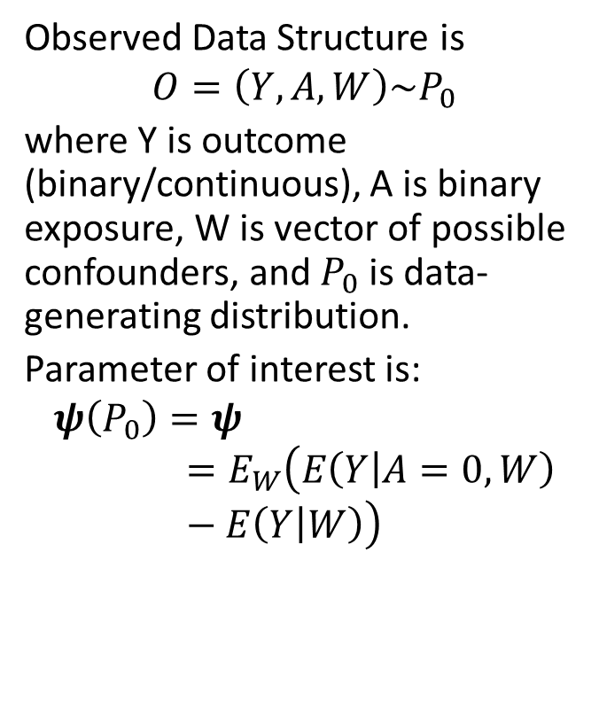
Variable Importance using Population Intervention Models
Statistical Methodology
Interpretation
Observed Data Structure is
$$O=\left(Y,A, W\right)\sim P_{0}$$
where Y is outcome (binary/continuous), A is binary exposure, W is vector of possible confounders, and $P_{0}$ is data-generating distribution.
Parameter of interest is:
$$ψ\left(P_{0}\right)=ψ=E_{W}\left(E\left(Y | A=0, W\right)−E\left(Y | W\right)\right)$$
Parameter of interest tailored to specific problem and since method is not tied to specific learning algorithms, one can combine multiple ML algorithms in a super learner for estimation.
Parameter represents “attributable risk” or “attributable fraction”, comparing overall mean of outcome to mean for target group (defined by A=0).
Parameter can be interpreted causally if: time-ordering assumption (W -> A -> Y); consistency assumption (O is missing data structure); no unmeasured confounding; and positivity assumption (Pr(A=0|W)>0).
Even without causal assumptions, parameter can be interpreted purely statistically.

Slide 5
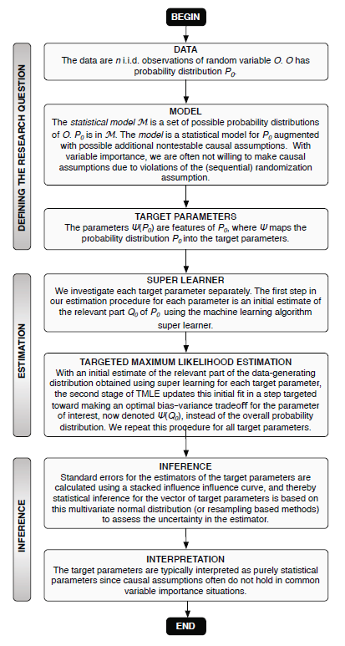
Targeted Maximum Likelihood Estimation
Overview
Statistical
TMLE is a double-robust estimator that is asymptotically consistent, asymptotically efficient, asymptotically normally distributed ( for inference), and has good finite sample properties. Used in causal inference analysis
Estimator is consistent if either treatment mechanism (g(0|W)) or outcome regression (Q(0,W)) is estimated consistently.
We use super learning as a data-adaptive meta-learner, with a library of ML algorithms, to initially estimate both treatment mechanism and outcome regression.
TMLE update (using clever covariate) changes initial estimates of parameter in a way that maximally removes bias and variance.
Confidence intervals can be constructed either based on efficient influence curves (2.5% and 97.5% quantiles) or with the non-parametric bootstrap.
TMLE for VIM using PIM in (Ritter, Jewell, and Hubbard 2014). Alternative VIM parameters based on more traditional causal inference methodology of creating two counterfactual distributions (A=1 and A=0) and estimating strata-adjusted mean outcomes.

Slide 6
Data and multiPIM package
New dataset, with covariates binarized in 24 hour periods and immediate headache level. Link is here: http://bit.ly/1A8TLtK
Assumed repeated point treatment (for 24-hour increments):
Time: in 24 hour increments
W(t): covariates in prior 24-hour hours
Y(t): Headache level immediately at the end of 24-hour period
Mean data imputation where necessary for some covariates.
O(t)=(W*(t),A(t)=W_{i}(t),Y(t)) for t=1,…,270 where W*(t) = {W(t) \ W_{i}(t)}
This model, though restrictive, allows us to use model, data structure, and estimator previously introduced.
multiPIM package (in R) provides functionality to do TMLE for Population Intervention Models.
Estimating treatment mechanism: main terms logistic regression.
Estimating outcome regression: Polymars (polynomial multivariate adaptive regression splines), lars (least angle regression), and main terms linear regression.
5-fold cross validation for Q super learning.
Confidence intervals based on efficient influence curve.

Slide 7
Preliminary Results
Interpretation: Parameter estimate is the effect, on overall mean headache level, of eliminating exposure. For example, removing high heart rate incidence (over 24 hour period) reduces mean headache level by 1 unit (holding all other measured variables constant).
Conservative estimates: Only included variables with low (α < 0.05) Bonferroni corrected p-values, which divides p-value by the number of comparisons being made. Though we likely eliminate false positives, we probably have some false negatives (e.g., sickness indicator).

Slide 8
Critical Decisions and Moving Forward
Variable importance: Parameter estimates (and inference) could change with more ML algorithms in candidate library, super learning for both Q and g, bootstrapping for statistical inference (instead of influence curve), more data (e.g., sleep, weather), inconsistent measures for headache level, dataset that incorporates missingness indicators for covariates (O = (∆, ∆W, A, Y)) and/or multiple imputation methods (e.g., MICE, Amelia II), different time scales (8 hours vs. 24 hours), and continuous exposures (as opposed to binary).
Prediction: VIM can be input into learning algorithms for real-time prediction, as a dimensionality reduction screening procedure.
Longitudinal Causal Inference: Need to go beyond repeated point treatment formulation (with possibly violated i.i.d. assumptions) and consider data structure incorporating time-varying covariates and time-varying treatment with counterfactuals indexed by interventions on more than one treatment node.

